Slide 1
ABOUT LLMS:-

Slide 2
Large Language Models (LLMs):-
LLMs are advanced Artificial Intelligence (AI) systems.
They are designed to understand and generate human language.
LLMs learn from huge amounts of text data such as books, websites, articles, and documents.
They use Deep Learning and mainly the Transformer architecture.
Examples: GPT, Gemini, Claude, and Llama.
Key Idea:
LLMs allow computers to communicate and work with humans using natural language.

Slide 3
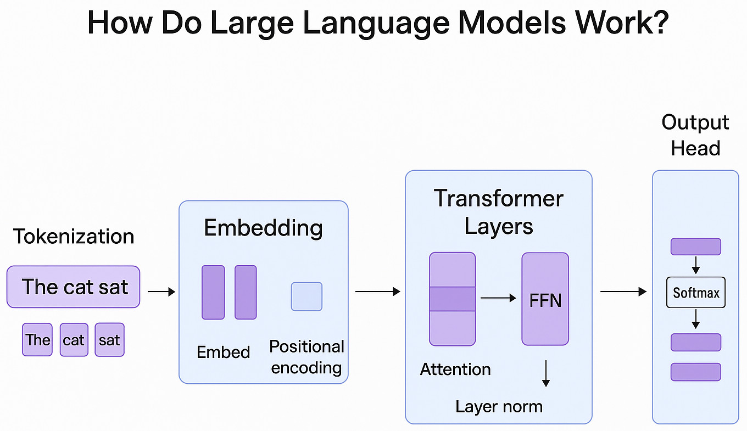
START
↓
User gives a Prompt
↓
Input is processed
↓
Text is broken into
Tokens/Words
↓
LLM understands the
Context
↓
Model predicts the most
suitable response
↓
Response is generated
↓
User receives
the Answer
↓
END

Slide 4
Applications of LLMs:-

Slide 5
APPLICATION:-
Saves time and improves productivity.
Provides quick responses to user questions.
Automates repetitive language-based tasks.
Supports multiple languages.
Helps in content creation and problem-solving.
Makes technology easier to interact with.

Slide 6
DISADVANTAGES:-
Can sometimes generate incorrect or misleading information.
Requires high computing power and resources.
Can be expensive to develop and operate.
May have bias in generated responses.
Raises privacy, security, and copyright concerns.

